Slide 1

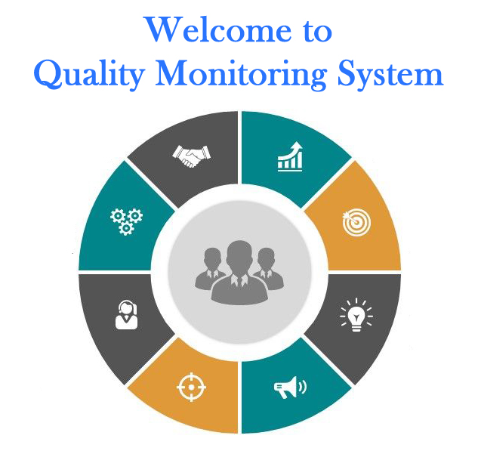
Quality Monitoring Framework for Government ITIs running under Public-Private Partnership (PPP)
Summer Internship Programme
in association with
Department of Technical Education, Training and Skill Development
Government of West Bengal
Group Members –
1) Subh Priyadarshi - BITS Pilani (Hyderabad campus)
2) Saransh Srivastava - BITS Pilani (Pilani campus)
3) Jay Sharma - BITS Pilani ( Pilani campus)
Skill Set Requirements: Web Development (through PHP version 8 – MySQL)

Slide 2
Our Mentors
Mr. Bappaditya Haldar, DIT
Mr. Siddhartha Bose, Addl. DIT as Nodal Officer
Project Guidance:
Mr. Nilanjan Kundu, ADIT
Mr. Arindam Acharyya, Principal, Govt. ITI, Haldia
Mr. Arnab Acharyya, ITI Specialist, SPIU
Mr. Ramesh Venkatraman as BITS Faculty Mentor

Slide 3
Special Acknowledgements
Mr. Saibal Sengupta, JDIT
Mr. Narayan Chandra Mandal, DDIT
Mr. Angsujit Das, DDIT
Mr. Sanjib Mondal, DDIT
Mr. Prasenjit Bose, ADIT

Slide 4
Benefits & Sharing of Knowledge Base
Benefits for BITS Students
Understanding of Government Organization work flow.
Experience in terms of Problem Identification, Problem Definition, Requirement Analysis to develop a Web Portal.
Acquired new technical skills like PHP, MySQL & Javascript.
Teamwork in a distributed work environment.
Benefits for DIT
Easily accessible and easy-to-use platform for monitoring learning outcomes of PPP operated Govt. ITIs
Important information related to academics in ITIs is maintained centrally in a place that can be accessed easily from anywhere.
Increase in quality and productivity of ITI Training by regular monitoring.

Slide 5
Project Modules
1. Attendance Monitoring.
2. Curriculum Progress Monitoring.
3. Quality monitoring through Monthly Assessment.
4. Teaching Monitoring Aids.
5. Placement Monitoring.
6. Virtual Inspection (added later on recommendation of Mentors)
7. Live Chat b/w the Users (added later on recommendation of Mentors)
Notes:
Only steps here

Slide 6
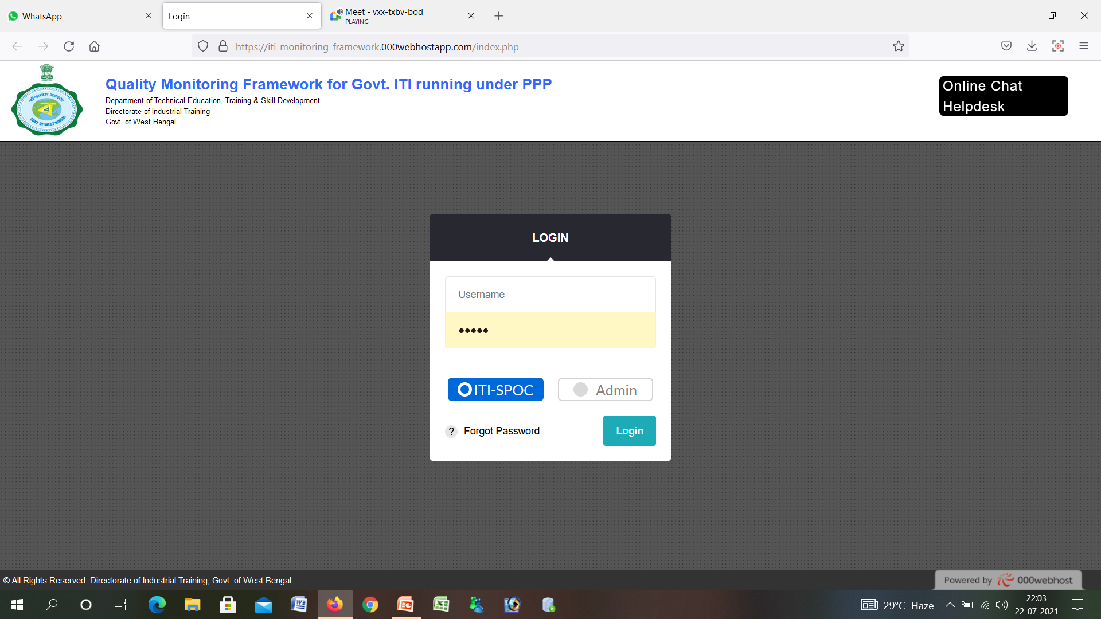
Website Link for Demonstration
Website-link
https://iti-monitoring-framework.000webhostapp.com/
Notes:
Insert the links for the localhosts login website.

Slide 7
Conclusion
Our project is a prototype - the system developed will serve as a sort of blueprint for developing more advanced, further-along-the-line systems for quality monitoring for the DIT. We are thankful to our mentors for this opportunity.

Slide 8
THANK YOU

